Slide 1

Project OOD
SCFMS
Smart Campus Facility
Management System
Intelligent Solutions for Modern Campus Operations
Sasi Sai Nadh Boddu
GWID: G22742105
Group 24

Slide 2

Introduction
Project Overview
SCFMS (Smart Campus Facility Management System) is an integrated platform designed to revolutionize how educational institutions manage their physical infrastructure. By combining real-time sensor networks, artificial intelligence, and cloud-based analytics, SCFMS creates a unified ecosystem that transforms traditional facility management from reactive maintenance to proactive optimization.
The system continuously monitors building systems including HVAC, lighting, security, and energy consumption, providing facility managers with unprecedented visibility and control.
The programming language used here would be Java.
Key Innovation
Unlike traditional BMS solutions, SCFMS integrates predictive maintenance algorithms that learn from historical data patterns to forecast equipment failures 7-14 days in advance, enabling proactive intervention.
24/7
AI
30%
Real-Time Monitoring
Powered Analytics
Cost Reduction

Slide 3
Major Function
User Authentication - Secure credential verification for system access control
Room Booking Management - Enable users to reserve and manage campus facility spaces
Room Availability Search - Real-time search functionality to find available rooms based on criteria
Check-in/Check-out Management - Track and manage room occupancy and usage
Maintenance Ticket Creation - Allow users to submit facility maintenance requests
Ticket Status Tracking - Monitor and track the progress of maintenance requests
Real-time Facility Monitoring - 24/7 monitoring of building systems (HVAC, lighting, security, energy) with AI-powered analytics

Slide 4
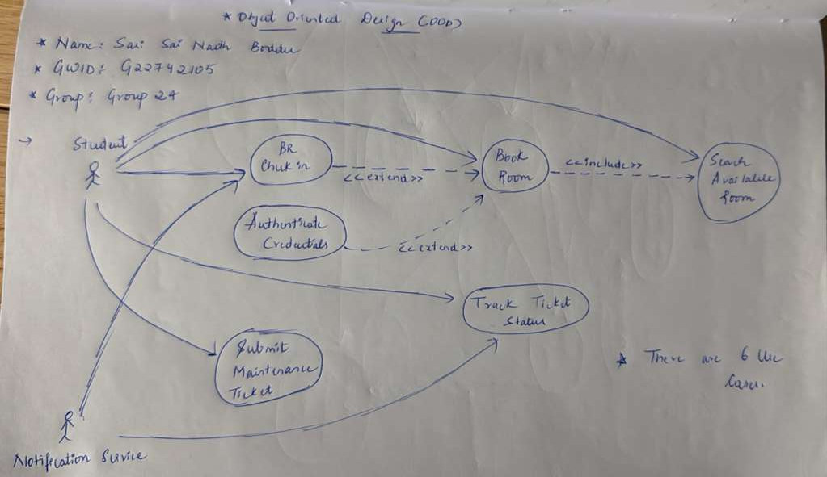
Use Case Model

Slide 5
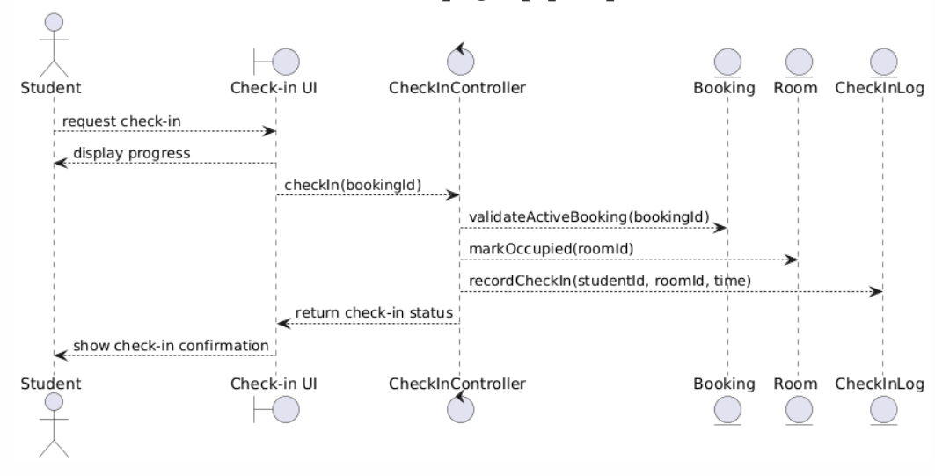
BR Check IN

Slide 6
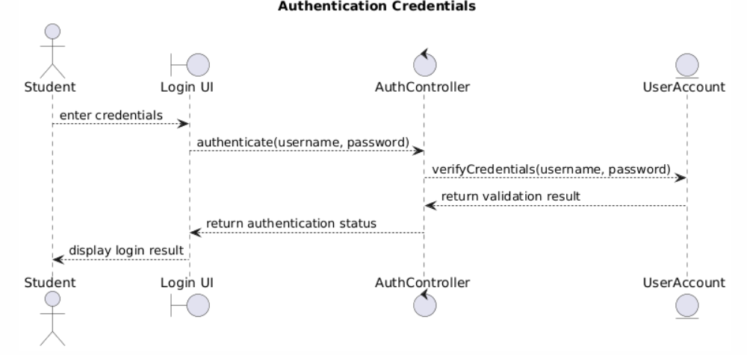
Authenticate Credentials

Slide 7
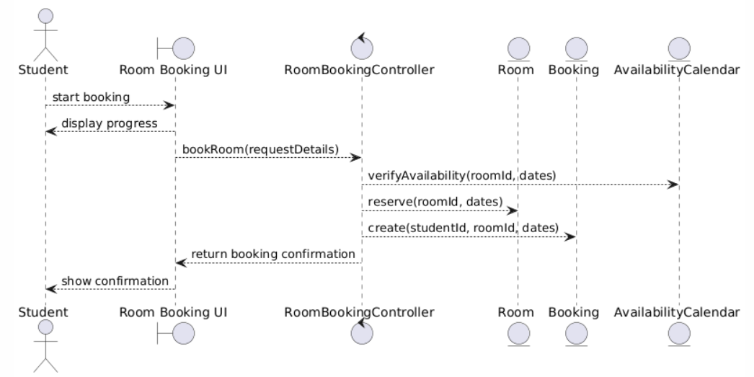
Book Room

Slide 8
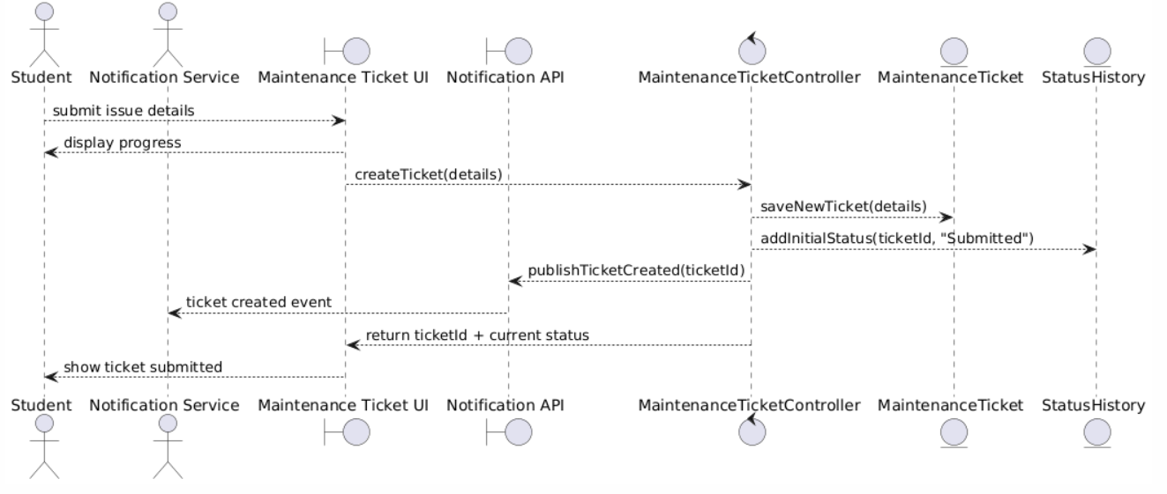
Maintenance Ticket

Slide 9
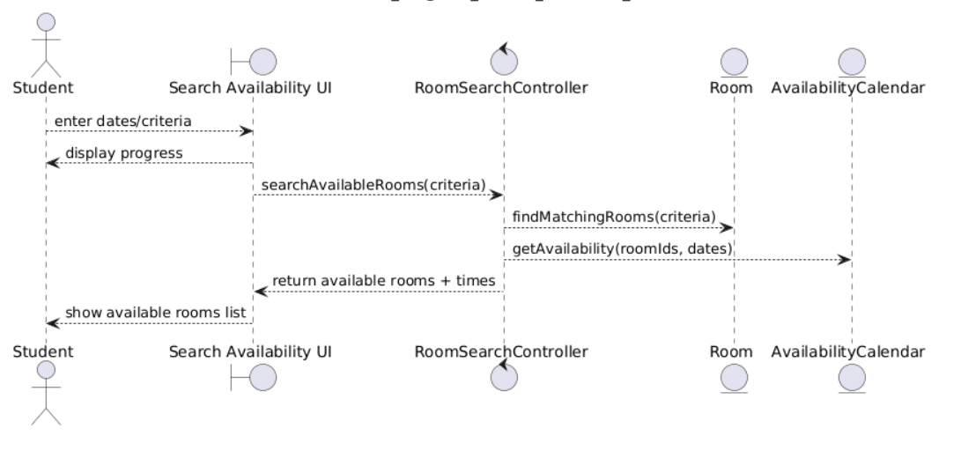
Search Availability

Slide 10
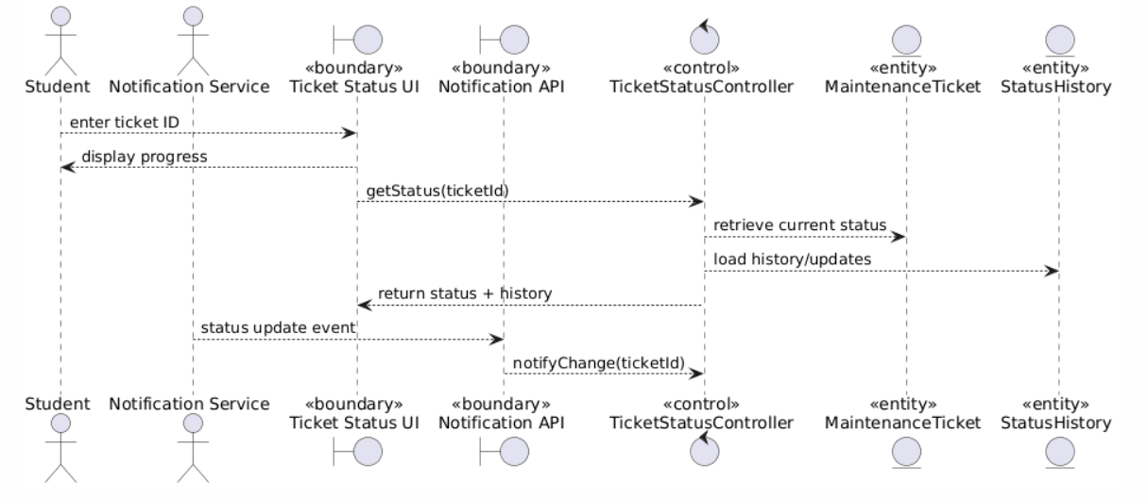
Track Ticket Status

Slide 11
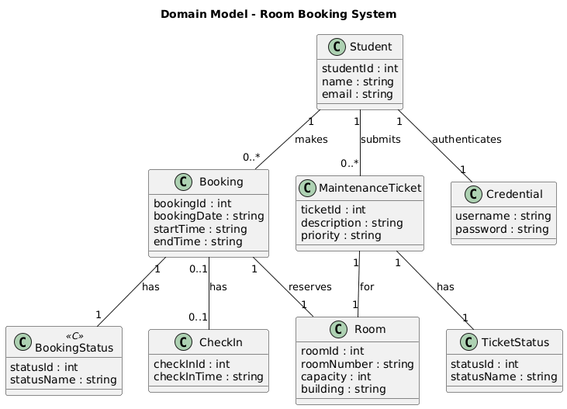
Domain Model

